Slide 1


Introduction to Bayesian Statistics
Or: how I learned to stop worrying and love priors

Slide 2




Intro
Henry Häkkinen
Post-Doc studying the effects of climate change on seabirds and how to plan effective conservation. Latterly branched out into impacts of renewable energy on biodiversity.

Slide 3
Content for today
What is a “Bayesian” approach?
A brief explanation of Bayes’ theorem
Building a Bayesian model
Model design
Priors
Running a model
Model checks
Interpreting output
Bayesian versus Frequentist statistics
Practical: running example models in R!

Slide 4
What is a “Bayesian” approach?
An alternative type of statistical inference than that of frequentist statistics.
We use data and our prior knowledge of a system to inform our statistical model, which then calculates the probability of patterns and relationship between variables
Data
Model checks
Model design
Run the model!
Output (posterior)
Priors

Slide 5
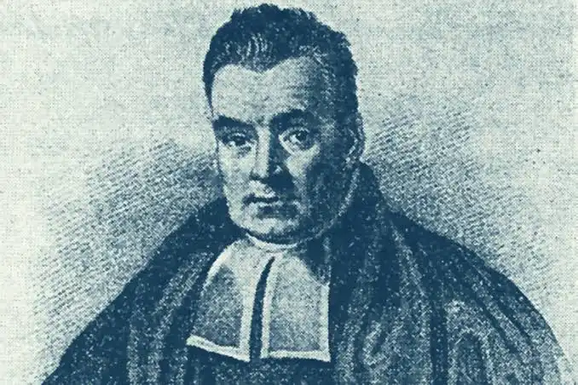
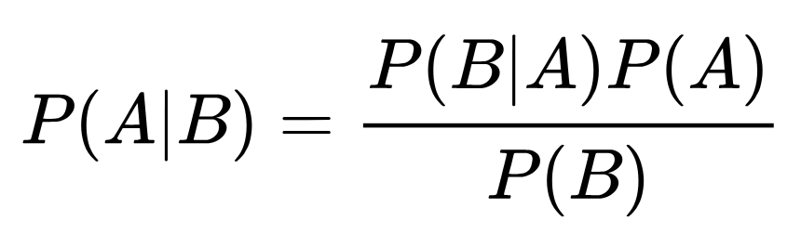
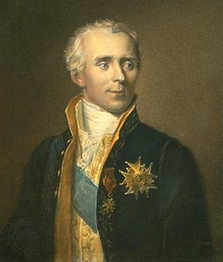
Bayes’ Theorem
The Bayes theorem describes the probability of event A conditional on event B (the probability of A after B has already occurred).
This is calculated using the probability of B conditional on A (what are the conditions of B that A occurs under) and the two separate probabilities of the events A and B.

Slide 6
Bayes’ Theorem
A simple example: What is the probability that a patient has a disease (A) given that they tested positive for that disease (B)?
P(A|B) is the probability that they have the disease, given that they tested positive. The posterior
P(B) is the probability that someone tests positive, whether or not they have the disease. The marginal probability
P(A) is the probability they actually have the disease (the overall incidence rate of a disease in the population). The prior.

Slide 7
Bayes’ Theorem
The Bayes’ theorem in practice:
“The serum test screens pregnant women for babies with Down’s syndrome. The test is a very good one, but not perfect. Roughly 1% of babies have Down’s syndrome. If the baby has Down’s syndrome, there is a 90% chance that the result will be positive. If the baby is unaffected, there is still a 1% chance that the result will be positive. A pregnant woman has been tested and the result is positive.”
What is the chance that her baby actually has Down’s syndrome?
48%! This is non-intuitive, but the knowledge of the general probability of prevalence has revealed some interesting information!

Slide 8
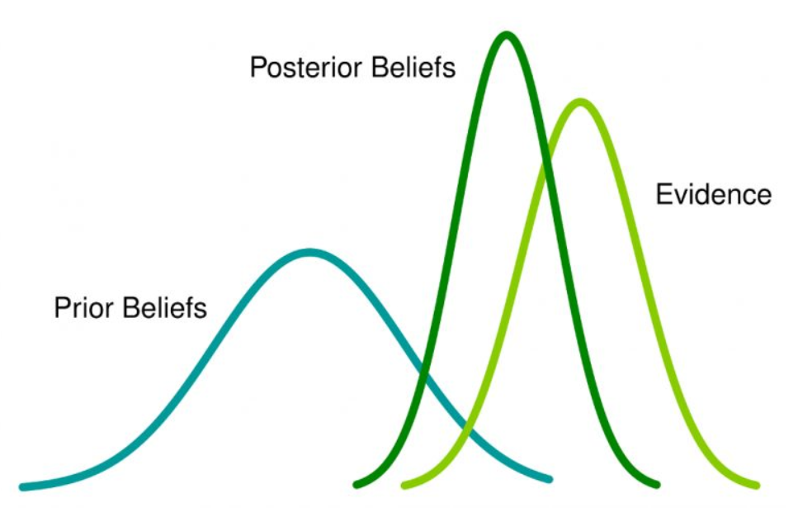
Graphical Summary
A Bayesian approach combines prior beliefs and evidence to form a posterior belief.
Source: https://ourcodingclub.github.io/tutorials/brms/

Slide 9
Wait, what are frequentist statistics?
Probably most, if not all, statistical tests you have done up until this point:
T-tests, linear models, GLMs, GLMMs etc.
Quick test: if it has a p-value it’s probably frequentist
In a frequentist approach we assume there is an overall global distribution, from which our data are just samples
E.g. normal, binomial, Poisson etc.
Frequentist statistics assess:
Whether the data fits our assumed distribution
Whether our data differs from a “null” distribution for hypothesis testing

Slide 10
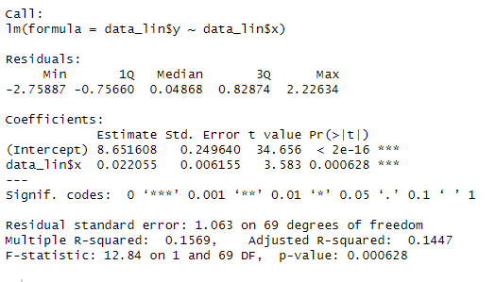
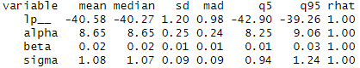
Frequentist versus Bayesian
Both are valid approaches for almost every statistical question, they just work differently
You are run a linear regression using a frequentist or Bayesian approach and they will likely give the same answer.
Both of the following models are linear regressions, y~x, where alpha is the intercept and beta the slope estimate

Slide 11
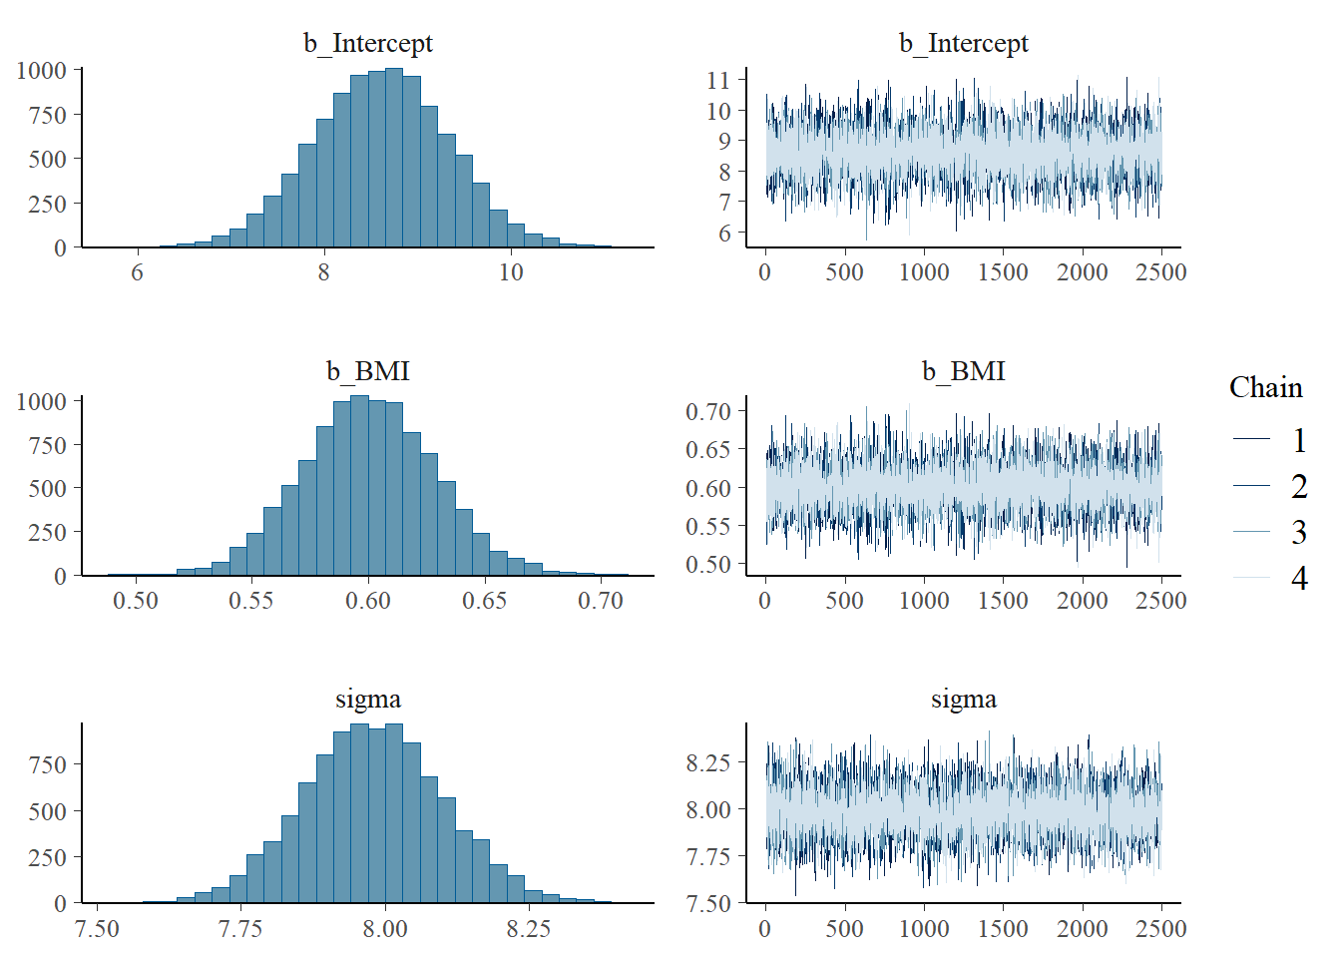
Frequentist versus Bayesian
Bayesian approaches do not have:
Point estimates for your parameters
P-values (though they can be bootstrapped)
Residuals (though they can be approximated)
Degrees of freedom (sample size compared to model complexity is much less of an issue)
Any real separation between fixed and random effects

Slide 12


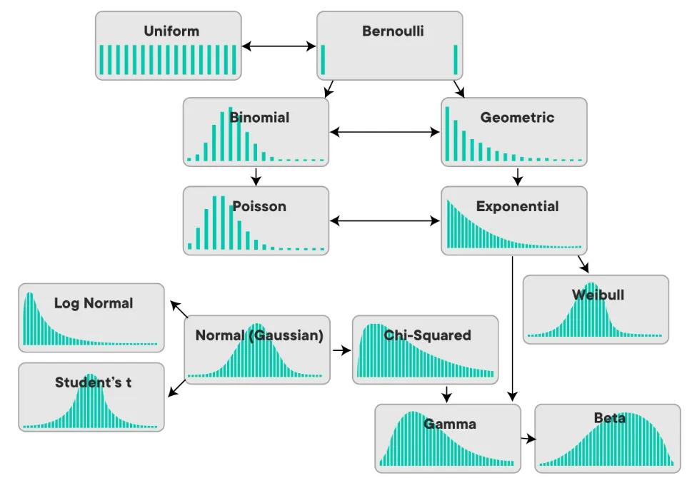
Part 1: Data and model design

Slide 13
Data and Model Design
We are going to run a simple example to illustrate a simple Bayesian modelling process
Data
Model checks
Model design
Run the model!
Output (posterior)
Priors

Slide 14
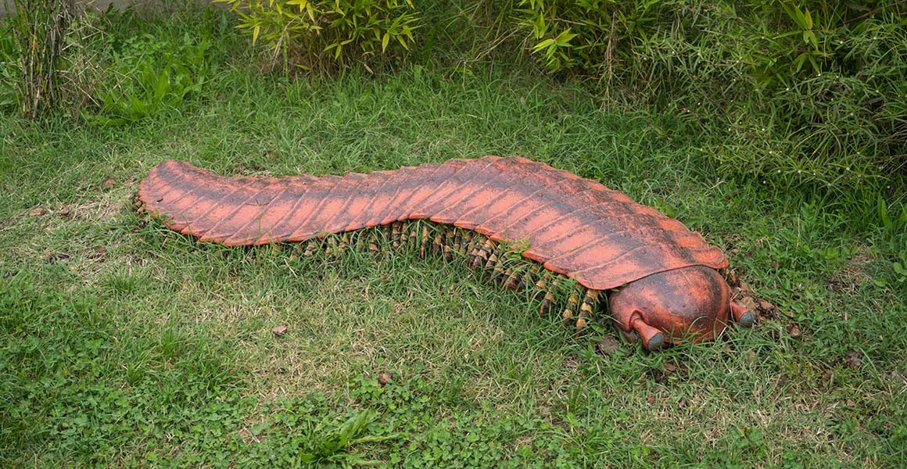
Example Data: Mutated Centipedes
Noddy-over-sands had a mysterious chemical leak in the 1950s. The cleanup was long and difficult but was declared safe by the government. However, local ecologists have noticed that centipedes and millipedes in the area of the spill are much larger than expected. They want to analyse past data and see if centipedes nowadays are larger than those of the past.
Source: Fabrizio Conte/ Shutterstock

Slide 15
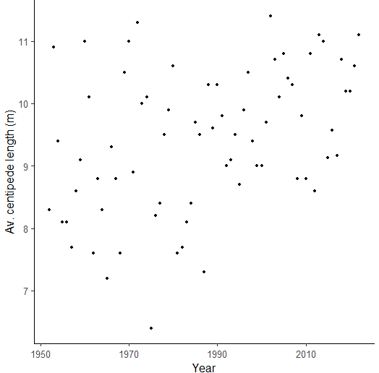
Example Model: Mutated Centipedes
A frequentist model requires a distribution to use as its basis. So do Bayesian models
Common examples are: normal, binomial, Poisson, negative binomial, beta, gamma…
We use this to model a relationship between predictors and response variables.
Always plot your data!
What kind of distribution does this look like?

Slide 16
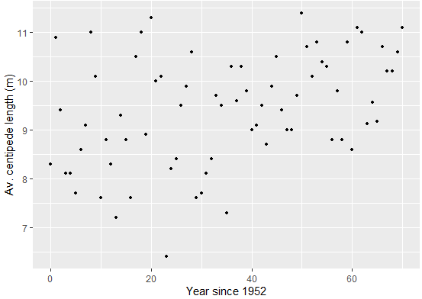
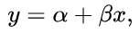
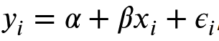
Example Model: Mutated Centipedes
This looks linear to me! I could use a normal linear regression with a frequentist approach, but I’ve decided to use a Bayesian approach.
What does a linear model look like?
y ~ a(x) + b ->
a is the intercept
b is the slope of the line

Slide 17
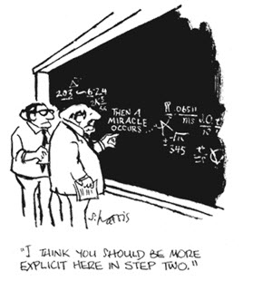
Part 1: Conclusion
We are going to make a linear regression.
We assume the equations linking x (predictor) and y (response) is a linear equation
We have two parameters: alpha (intercept) and beta (slope)
Using an explicit Bayesian approach for this is a little like hitting a moth with a sledgehammer, but simple examples are a good way to learn!
Source: https://dziganto.github.io

Slide 18

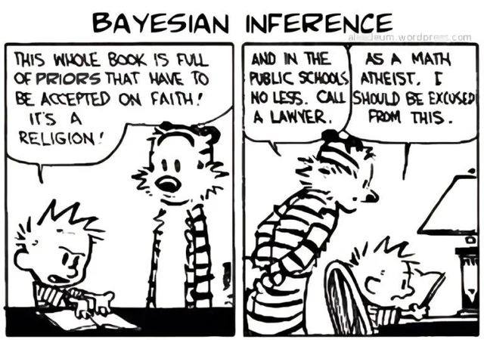
Part 2: Priors
Data
Model checks
Model design
Run the model!
Output (posterior)
Priors
https://xkcd.com/1132/

Slide 19
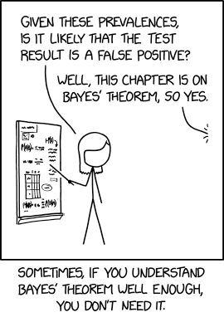
What is a prior?
Relevant information we should incorporate about this system. It is our prior expectation.
If this is not a new study system, there may be information about what you expect to see
For example, mortality rate in a wildlife population can be estimated from previous work
Priors provide the model information to use, and inform it what are the expected results and estimates for our parameter.
Source: https://xkcd.com/2545/

Slide 20
What is a prior?
Priors can seem odd at first because they are not objective observations, but subjective decisions.
You can make priors flexible so if they are wrong, then your model can adjust and update the priors.
Think of priors as a good starting point for your model, not as prescriptive.
They are more important when you have a small sample size, as they have a larger influence over the posterior distribution
Source: https://ourcodingclub.github.io/tutorials/brms/

Slide 21
Example Priors: Mutated Centipedes
What kind of priors can we discern about our system?
We have two parameters, so we need two priors.
What would make a suitable “null” prior?
?

Slide 22
Example Priors: Mutated Centipedes
We have two parameters, so we need two priors.
What is a reasonable expectation for our intercept (alpha)?
It cannot be below 0, otherwise hard to tell. So we should set a positive prior.
Otherwise it could be anywhere between 6-12 (and probably in the middle)
?

Slide 23
Example Priors: Mutated Centipedes
We have two parameters, so we need two priors.
What is a reasonable expectation for our slope (beta)?
We have no expectation on positive or negative slope (null hypothesis is slope is 0), but it could be either
So we set a prior with a centre point of 0, but with the flexibility to move to positive or negative.
But how much flexibility?
?

Slide 24
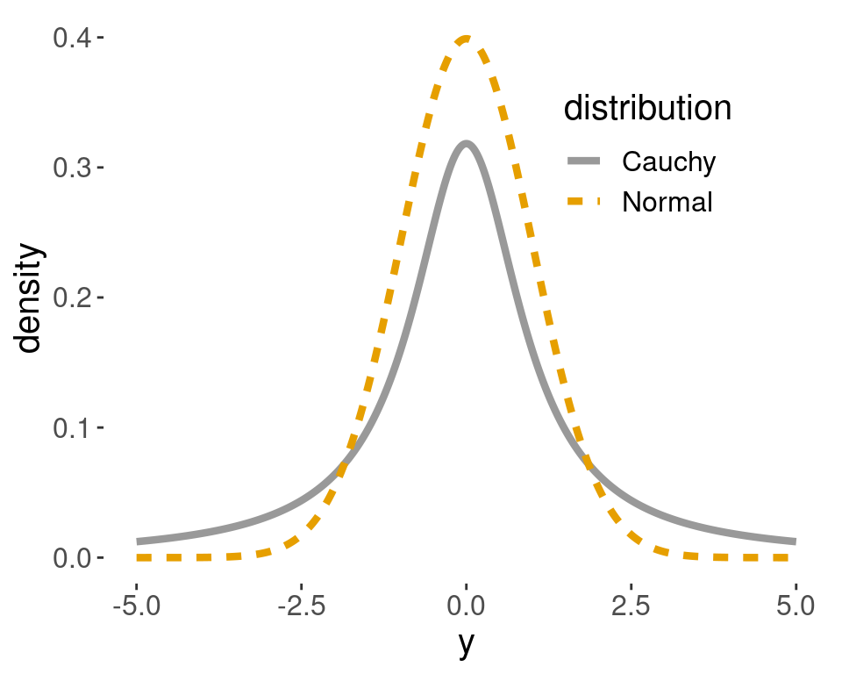
Defining a prior
For linear regressions we often have a null hypothesis that there is no relationship between a predictor and the response variable (i.e. slope is 0).
In which case we might assume our β prior is around 0, but might be positive and negative
We can restrict this by setting a limit on how positive or negative it can be.
A strict limit is referred to as “strongly informative” or “enthusiastic” prior
A loose limit with a lot of flexibility is referred to as a “weakly informative” or “skeptical” prior

Slide 25
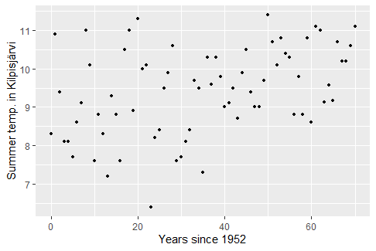
Defining a prior

Slide 26
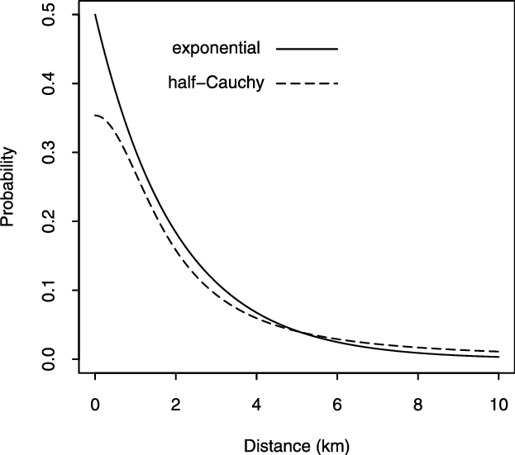
Defining a prior
In other cases we may expect a parameter to always be positive, but likely to be close to 0 if the null hypothesis is true.
And so on! There are many types of different distributions for different applications.

Slide 27
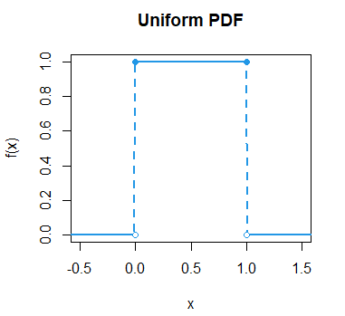
Uninformative priors
If we have no prior information about the system we can set an “uninformative” prior
Many people favour this as it appears to be “neutral”, but beware! It can bias results more than an informative prior!
It can also cause models to be a lot slower as it has more parameter space to check
Common sense will often tell us some results are impossible
E.g. cannot have a negative mortality or growth rate!

Slide 28
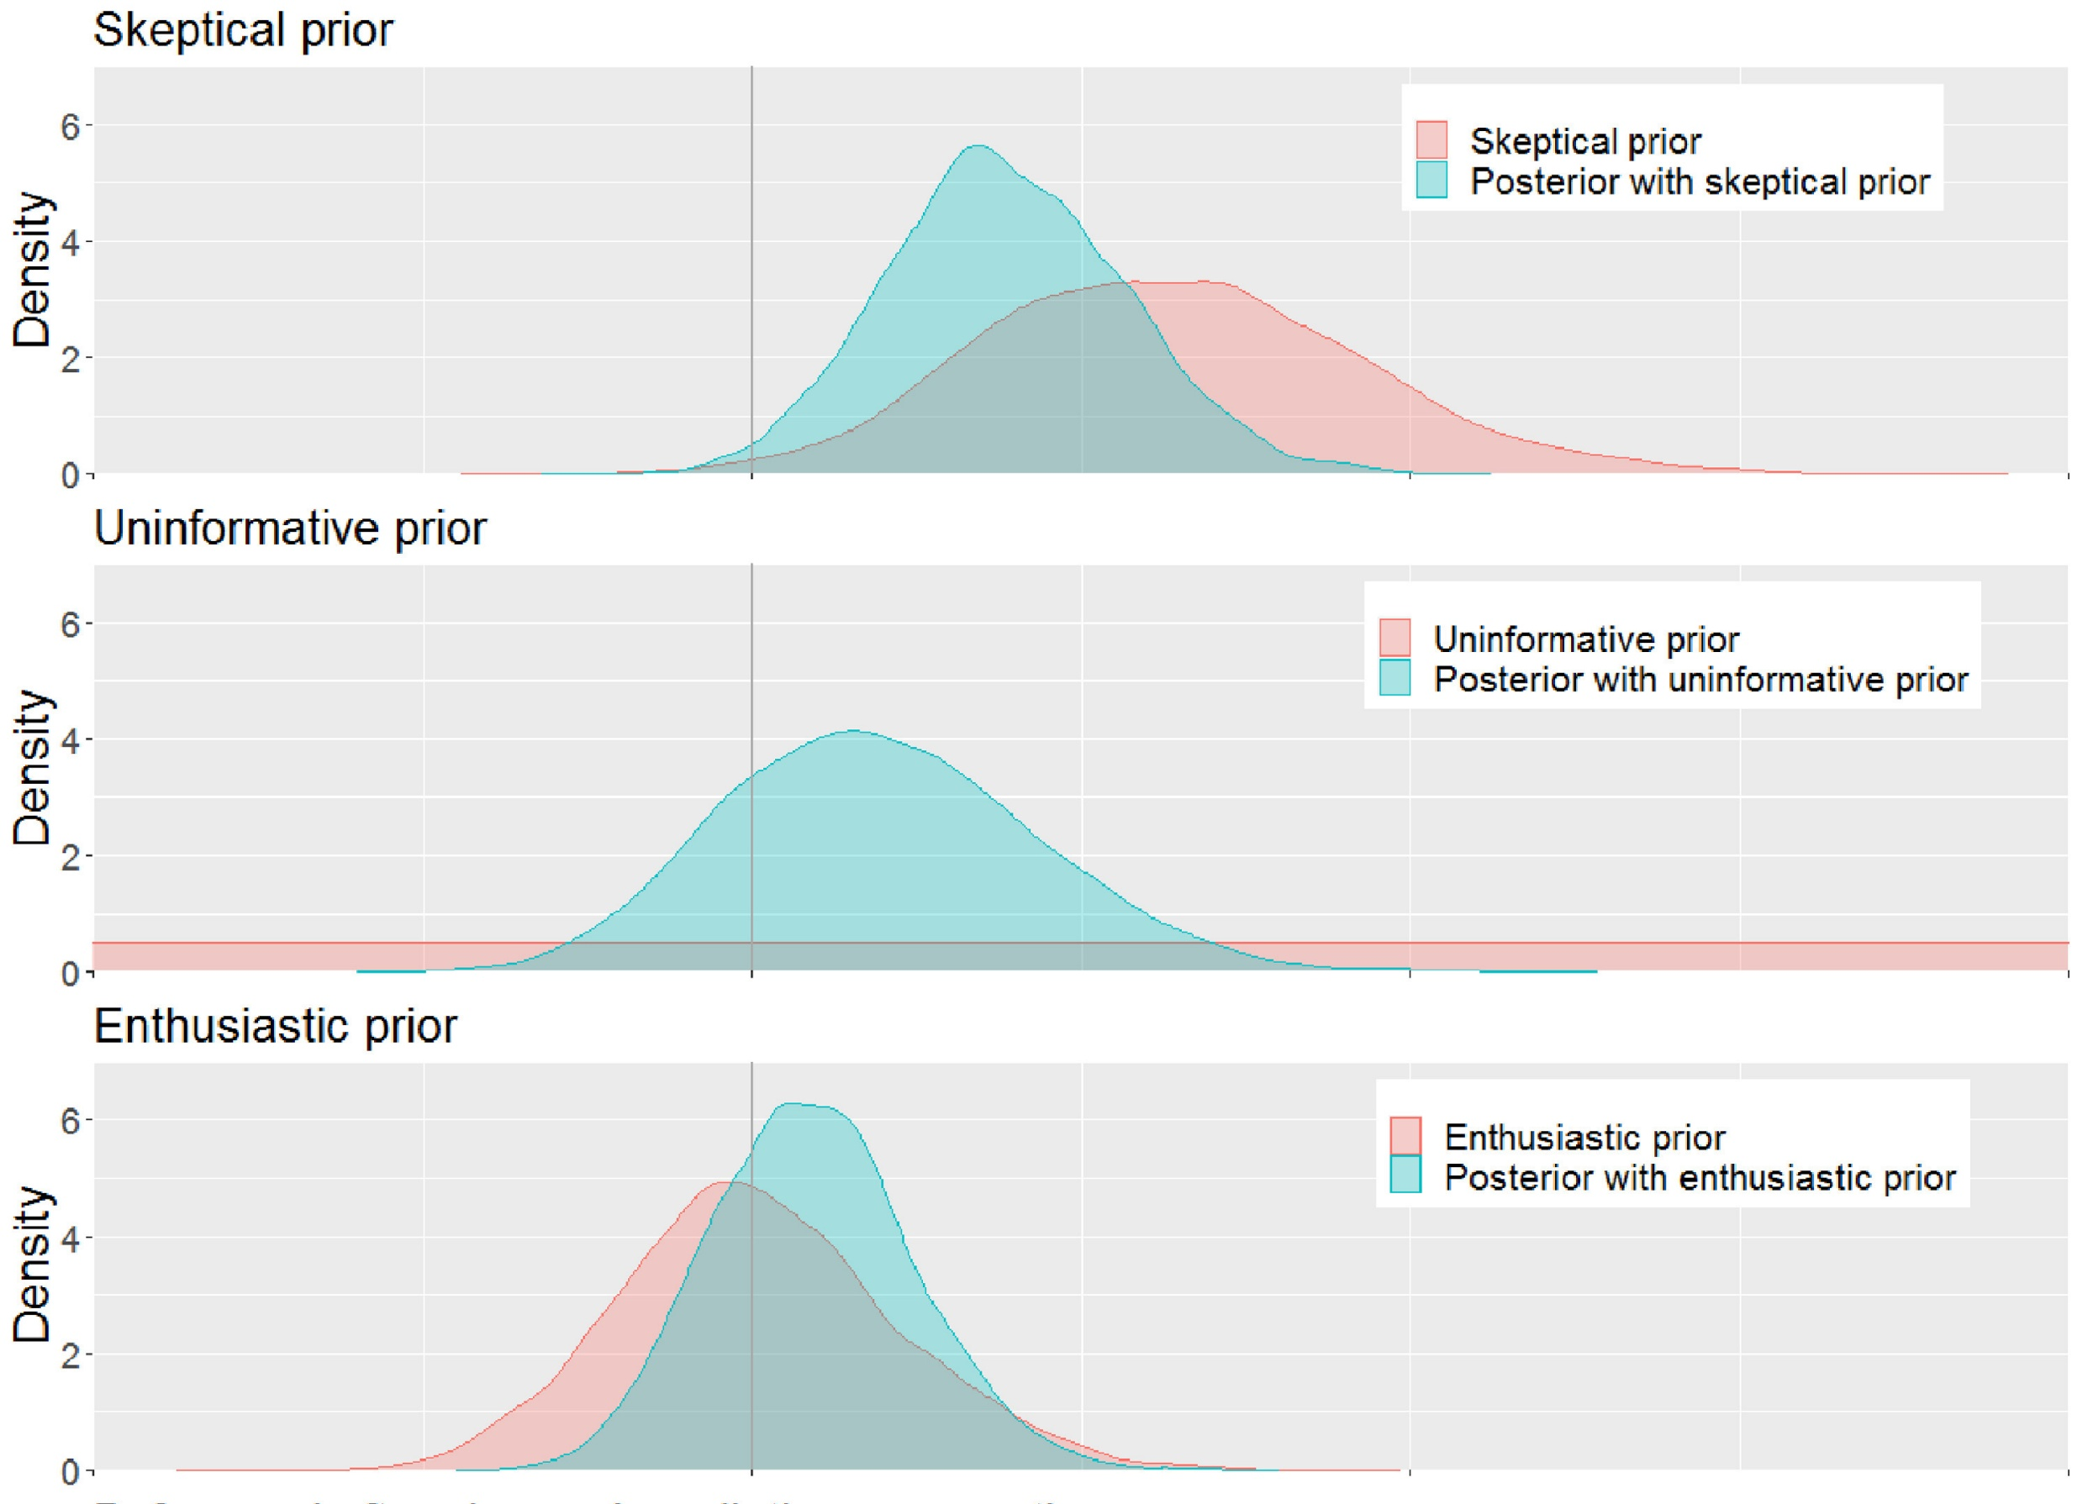
Your choice of priors can affect your results. Always make sure you can defend your priors.

Slide 29
The Bayesian Approach: Example
It is up to us on how restrictive or flexible the priors are
The smaller the sample size, the more important your priors are!
Some packages choose priors for you, or hide them altogether. Be VERY careful when using these.
https://www.redjournal.org/article/S0360-3016%2821%2903256-9/fulltext

Slide 30
Part 3: Running the Model
Data
Model checks
Model design
Run the model!
Output (posterior)
Priors
https://xkcd.com/1132/

Slide 31
Build and run the model
There are a lot of ways to build models in R!
They all use the same mathematical approach, but notation and technical details differ:
Rjags
Rstan (and cmdstanr)
rstanarm
brms
R2OpenBUGS
LaplacesDemon
And probably more….
Some are very technical and require a lot of work to run. Some hide a lot of the Bayesian aspects to make it look more like a standard frequentist model. Which you use is up to you, but I really dislike packages that “pretend” they’re frequentist so they look more friendly, I would advise to avoid them

Slide 32

Build and run the model
We are going to use rstan (with cmdstanr as a helper package)!
It runs C++ in the background, rstan is just the R wrapper on the top
It is extremely fast, powerful and flexible, BUT requires some knowledge and work to get it to work
Many (if not most) Bayesian packages are based on stan, but are simplified
I will teach using stan, because
All the major principles are the same across packages
It forces you to be specific and to understand all the major components of a Bayesina model
If you understand rstan, then many other packages are very similar, but easier!

Slide 33
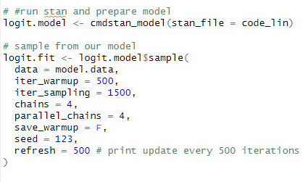
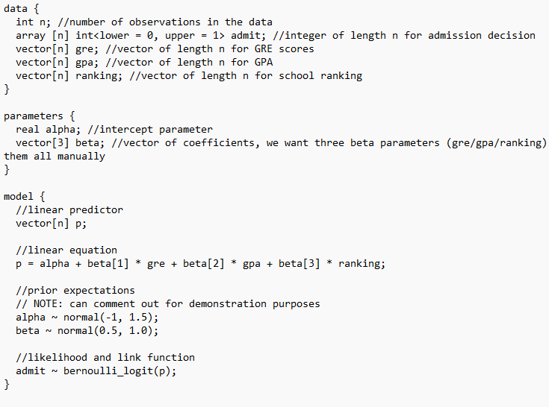
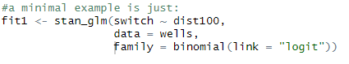
Build and run the model
Complexity varies between packages…
Stan model:
Stanarm. Uses all the same structures, but hides them under the hood

Slide 34
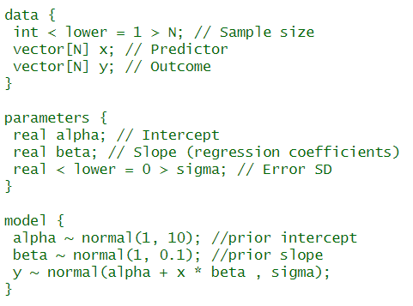
Example: Mutated Centipedes
Stan has three parts to a model
Data: we have to state all the relevant parameters, including sample size! We have to declare what type of data it is.
Parameters: we have to declare all the parameters in the model, and an error term
Model: we have to declare the formula for our model, and our model priors.
For most common models, you can find many examples online.

Slide 35

How does a Bayesian model actually work?
Bayesian models will take the input data and model and try to estimate the best possible answers and present its results for parameter estimates

Slide 36
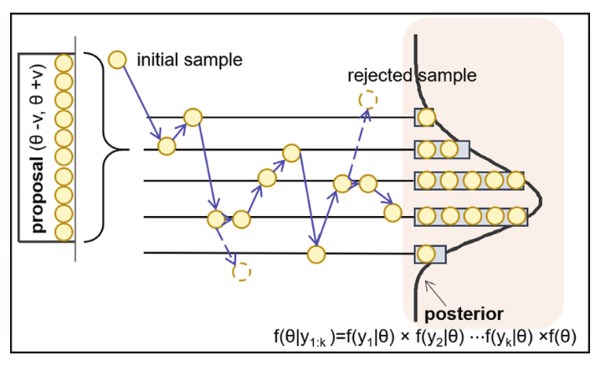
How does a Bayesian model actually work?
How? Through iteration.
It will try lots of different combinations of parameters, measure how well these fit the data (through log-likelihood fitting), and report back what it finds.
It will use previous results to improve its guesswork going forward.
This approach is collectively known as Monte Carlo sampling, of which there are various sub-types.
Source: https://doi.org/10.5772/intechopen.82781

Slide 37
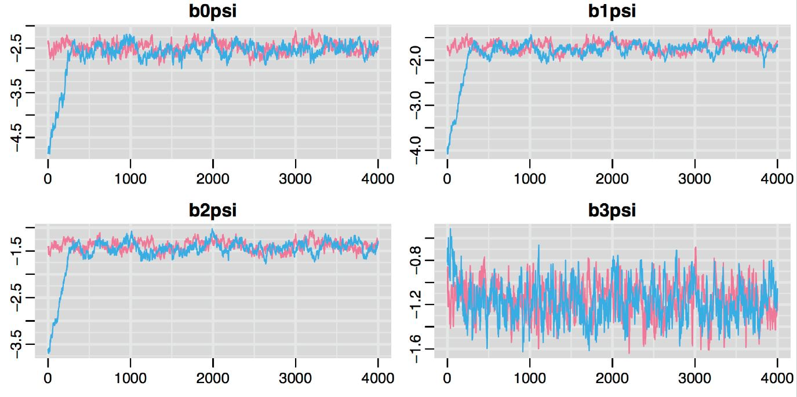
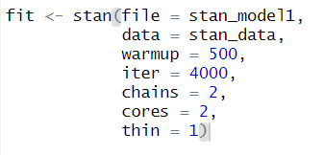
In total, a Bayesian model will often run thousands of iterations, and will “converge” towards a consensus answer. The answer will never be perfect, but will be very close to the correct answer.

Slide 38
Key options when running a model
Iterations: how many times should the model look for an answer? The more iterations, the more likely our posterior distribution will be representative of the true parameter estimate
Burn-in/warm-up: how many times should the model train itself before we start logging the output? The longer the warm-up, the more likely the model will converge towards a solution before we start sampling the posterior
Chains: how many times should the model run a warm-up and posterior sampling process? Each time will be independent and multiple chains will ensure the model is “stable!
Thin: estimates within a chain will correlate since they build on previous estimates. How many iterations should we skip between sampling?
Cores: if you have a multi-core processor, how many cores should be used for parallel processing

Slide 39
Side note: iterations are not inherently Bayesian
Until recently most statistics were not Bayesian
Why? Because it was not possible to evaluate the integrals of most probability distributions directly, which is required to calculate the posterior distribution
Computing power means we can now solve Bayesian probability equations numerically, i.e. through iteration!
Several frequentist packages in R secretly use iterative processes but they tend to be hidden from view. However, they work very similarly!

Slide 40
Part 4: Model checks and diagnostics
Data
Model checks
Model design
Run the model!
Output (posterior)
Priors
https://xkcd.com/1132/

Slide 41

Model checks and diagnostics
Once the model finishes, we need to check it ran correctly.
Did the model find a valid solution to adequately fit our data?
Source: https://agricology.co.uk/blog/flower-power/

Slide 42
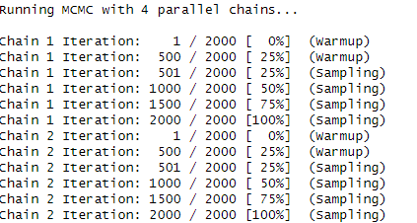
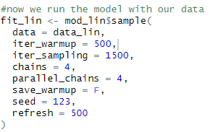
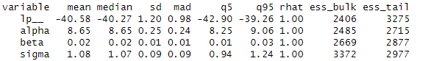
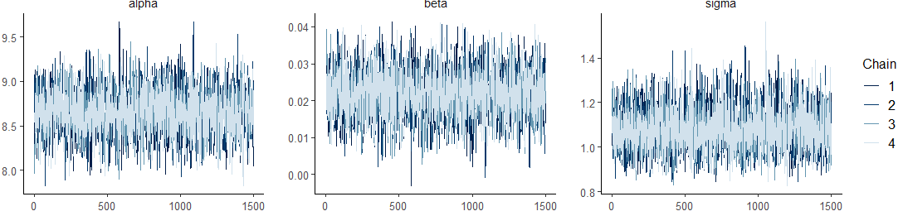

Slide 43
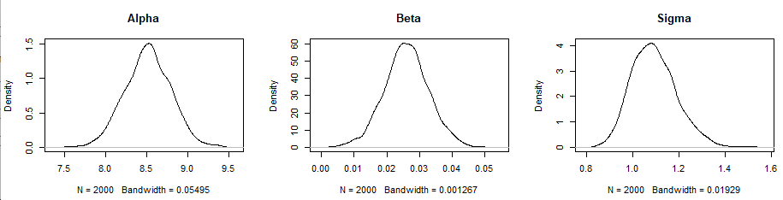
Checking the posterior distribution
Parameters should usually look normally distributed.
Multiple peaks means model cannot find a single, valid solution
Strong skew sometimes mean your priors are constraining the model

Slide 44
Key checks for model convergence
Model converges to stable space, all chains show similar behaviour
“fuzzy caterpillar”
Rhat should be close to 1.0
Do posterior distributions look sensible?

Slide 45
Part 5: Understanding the Output
Data
Model checks
Model design
Run the model!
Output (posterior)
Priors
https://xkcd.com/1132/

Slide 46
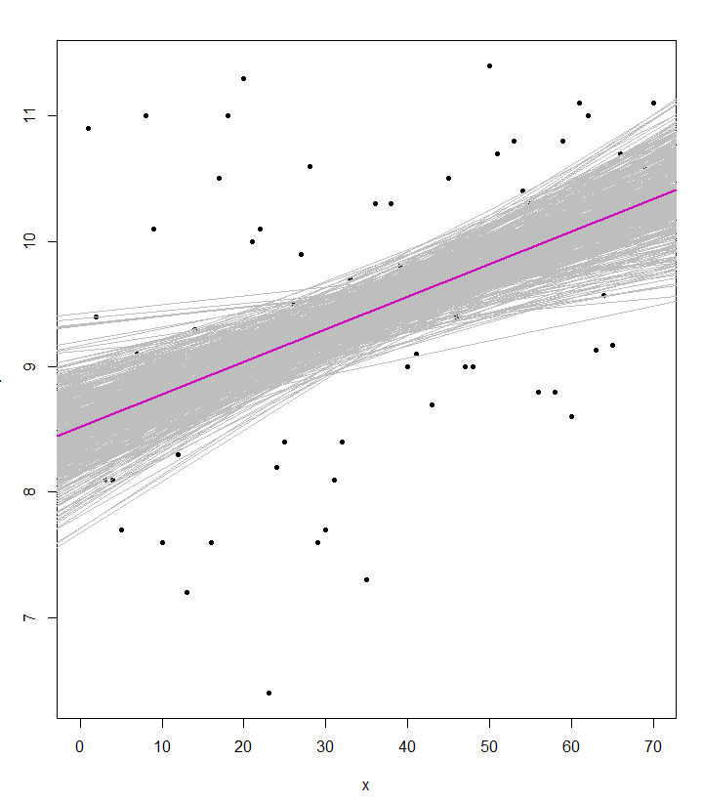
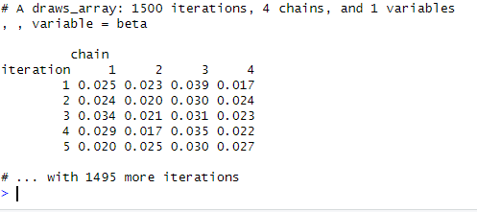
Part 5: Understanding the Output
Bayesian models do not give point estimates, standard errors, or p-values!
Instead, they have an estimate per parameter per iteration, these are then formed into a posterior distribution

Slide 47
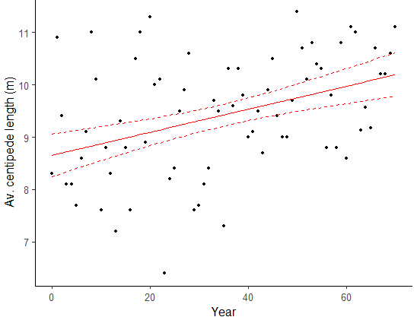
Part 5: Understanding the Output
Bayesian models do not give point estimates, standard errors, or p-values!
Instead, they have an estimate per parameter per iteration, these are then formed into a posterior distribution
We can use this to make a mean estimate, and a 95% credible interval

Slide 48
Checking model fit
You cannot calculate classical residuals in a Bayesian approach
But that doesn’t mean we cannot check model performance!
Key ways to check are:
Posterior predictive checks = can our model predict our data well? Does it have any obvious flaws?
Validation = build the model with a part of the data-set, can it successfully predict the left-out part
Note: some packages provide pseudo-residuals, but they are technically different to ones you’re used to. Read up on them if interested!

Slide 49
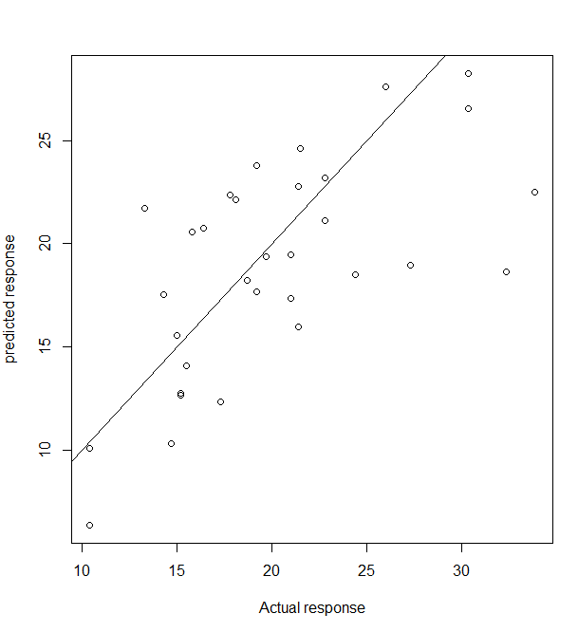
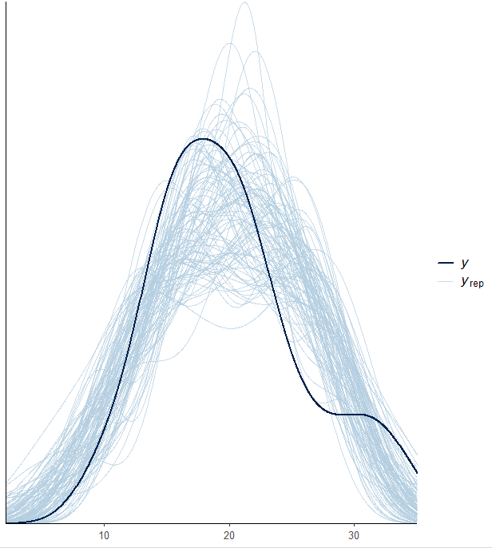
The Bayesian Approach: Example
Posterior predictive checks = can our model predict our data well? Does it have any obvious flaws?

Slide 50
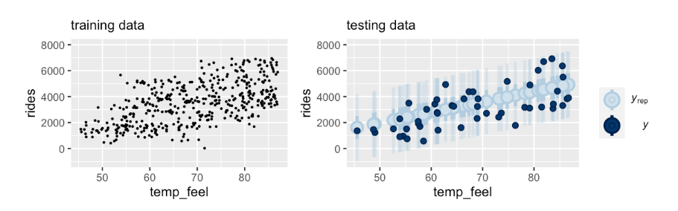
The Bayesian Approach: Example
Validation = build the model with a part of the data-set, can it successfully predict the left-out part?
y
y
x
x

Slide 51
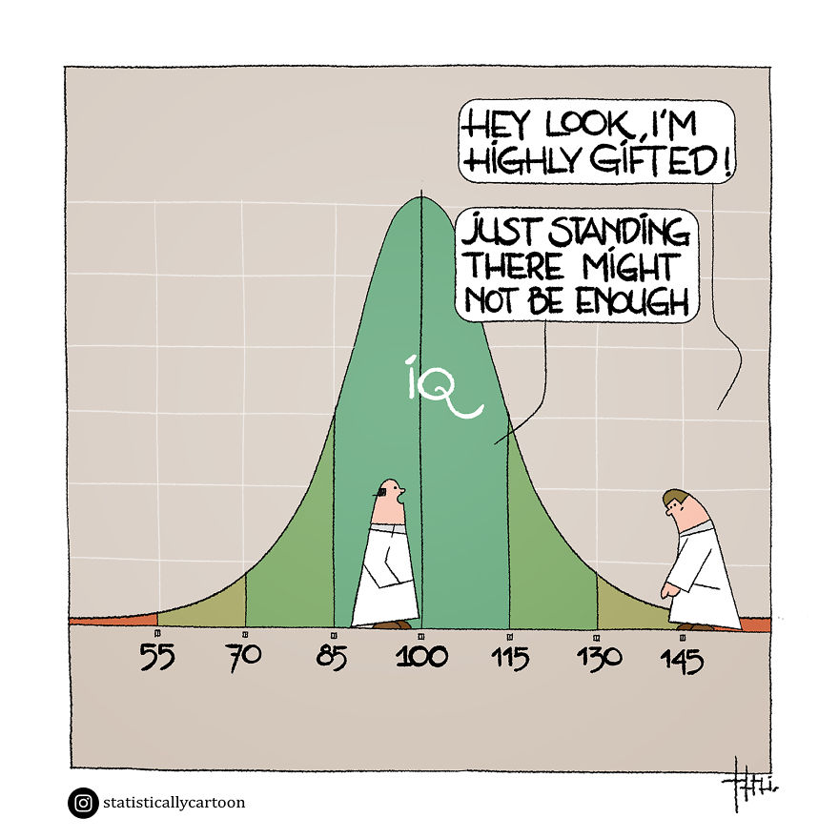
Part 6: Model Comparisons
Source: Raf Schoenmaekers

Slide 52
Model comparisons
Sometimes we might want to build different models with different priors, model structures and parameters. In which case we need to compare them and find which performs better
In a frequentist framework, we might use AIC, etc
Bayesian frameworks have equivalents, that essentially work the same way!
Common ones include: BIC, WAIC, etc
The most commonly used (and recommended) option is LOO (leave-one-out cross-validation)
In theory it would rebuild a model without a single data point and then see if it can predict it accurately. This would normally take ages, so we approximate this process through PSIS
LOO is an excellent estimate of model fit, and can spot outliers in your data that don’t fit your distribution

Slide 53
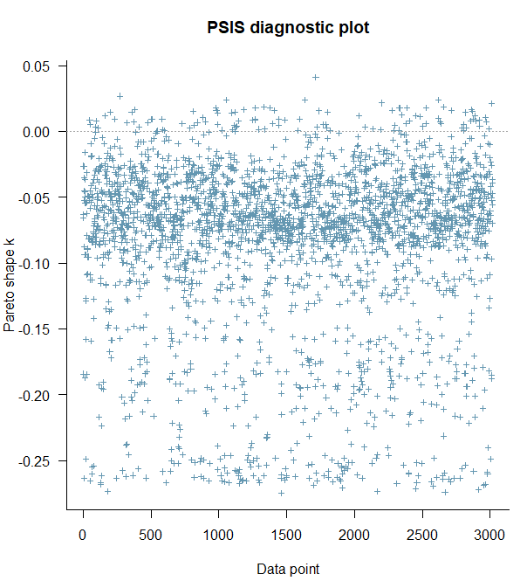
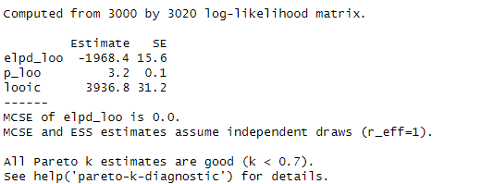
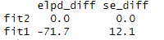
LOO

Slide 54
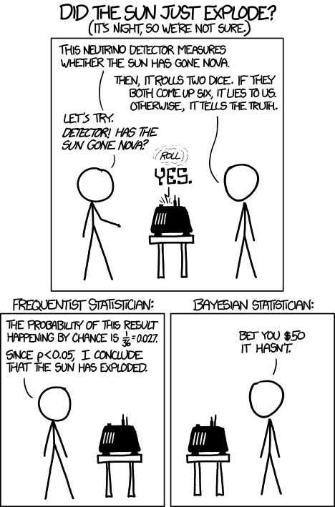
Part 7: Frequentist vs Bayesian (again)
https://xkcd.com/1132/

Slide 55
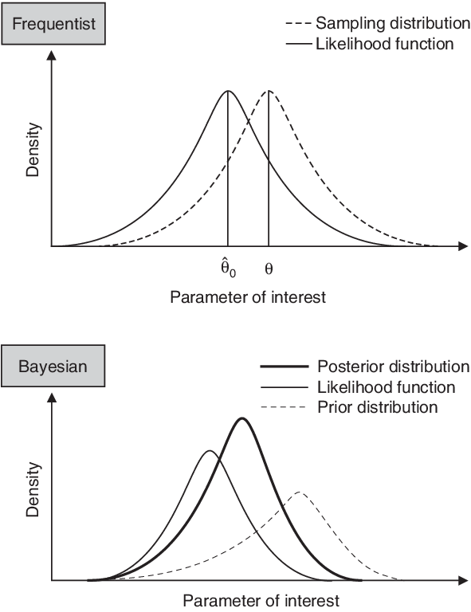
Frequentist versus Bayesian
Frequentist models:
Have an intrinsic null hypothesis
Estimate probability of seeing the data given the hypothesis
Parameters are fixed, models return point estimates with associated errors
Uses confidence intervals
Bayesian models:
Have prior beliefs, but no formal null hypothesis testing
Estimate probability of a hypothesis given the data by using prior beliefs
Parameters are estimated as a probability distribution
Uses credibility intervals directly representing probability
Source: https://doi.org/10.2165/00019053-200725080-00003

Slide 56
Frequentist versus Bayesian
Advantages of Frequentist approach:
Generally faster, especially for simpler models
Still standard approach in ecology so better tutorials and support
Larger array of tools and packages to solve standard problems, little customisation needed
Results are (often) more interpretable, with single estimates
Advantages of Bayesian approach:
Generally better at modelling complex systems, especially with small sample sizes
Much more powerful and flexible, can solve statistical problems that frequentist approaches cannot
Credible intervals are usually more robust, generally give a more intuitive sense of uncertainty

Slide 57
The Bayesian Approach: When do I use it?
If it makes sense for your data (heavy conditional probabilities)
If standard frequentist methods don’t work
Small sample size?
Lots of random effects?
Highly hierarchical data?
No standard distributions work?
Other problems that can’t be modelled easily in a frequentist approach (e.g. heteroskedasticity)?
Bayesian approaches rely heavily on iterative problem solving, they can be used to solve many difficult statistical problems.

Slide 58

Questions?

Slide 59
Part 4: Exercises

Slide 61
Side note:
Broadly speaking there are four branches of statistical inference you are likely to come across
Inferential Statistics
Frequentist Statistics
Bayesian Statistics
Likelihood
Information Criteria
Common uses:
Maximum Likelihood Estimation
Likelihood-ratio tests (model comparison)
Common uses:
Aikake Information Criterion (AIC)
Relative model quality and model selection
Some approaches combine these!

Slide 62
What is a “Bayesian” approach?
An alternative type of statistical inference than that of frequentist statistics.
https://esajournals.onlinelibrary.wiley.com/doi/10.1890/14-0661.1
https://tobiasroth.github.io/BDAEcology/basics.html
https://besjournals.onlinelibrary.wiley.com/doi/10.1111/2041-210X.13407

Slide 63
Cut?: What are statistics?
The collection, organization, analysis, interpretation, and presentation of data
In science, we often use “statistics” as short-hand for “inferential statistics” which examines properties of data in relation to underlying probability distributions
This includes hypothesis testing! And most forms of classical models!
Alternatives include “descriptive statistics” which we use all the time (mean, median, standard deviation etc.)
In inferential statistics we attempt to quantify any patterns in our data, and just as importantly, the uncertainty around those conclusions.

